Slide 1
www.MINEPORTAL.in
ONLINE TEST SERIES FOR
GATE MINING
COAL/METAL FIRST/SECOND CLASS
COAL INDIA MT MINING EXAM
OVERMAN/SIRDAR EXAM
OTHER PSU MANAGEMENT TRAINEE EXAM
FREE STUDY MATERIAL/VIDEO LECTURES
ONLINE ORDER MINING BOOKS
CALL/WHATSAPP-8804777500 www.fb.com/mineportal.in

Slide 2


Mine Gases, Detection &
Maintenance of fire seals

Slide 3

What do I need to know?
What gases make up fresh air
What are the hazards of mine gases
Specific Gravity of each gas
Origin of mine gases
Explosive range
Exposure limits
What detection device(s) do I use

Slide 4

Category of Gases
Noxious – Asphixiant due to a lack of oxygen.
Toxic – Poison, either long or short term exposure.

Slide 5

Physics of Gases
Specific Gravity : The combinations of gases that make up air is what other gases are compared with. Air is considered to have a specific gravity of 1.0
Temperature: Cold gases will diffuse slowly, hot gases will diffuse quickly.
Graham's Law: The rate of diffusion, the lower the specific gravity, the faster it will diffuse.
Barometric Pressure: The lower the pressure, the faster a gas will diffuse.
Solubility: The ability to dissolve in water.

Slide 6

Exposure Limits
Threshold Limit Value (TLV) The allowable amount of gas exposure for an 8 hour day for 5 days a week without harmful effects.
Short Term Exposure Limit (STEL) The allowable amount of gas exposure for 15 minuets.

Slide 7
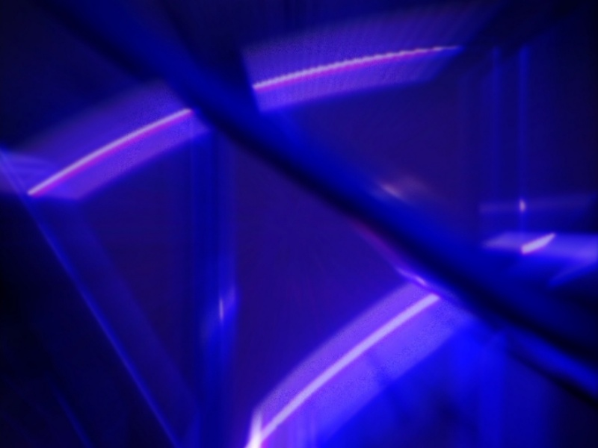
Measurement of Gases
Parts Per Million (PPM)- The most accurate measurement of a contaminant in the atmosphere.
(4)
PERCENT PPM
1.0 ........................................10,000
.1 .....................................… 1,000
.01 ...................................… 100
.001 ..................................… 10
.0001 ................................… 1

Slide 8

Mine Gases & their Components
  AIR
    Chemical Formula: None
    Specific Gravity: 1.000
    Source: Atmosphere
    Characteristics: No color, odor, or taste
    Pure dry air at sea level contains the following:
      Oxygen...................... 20.94 %
      Nitrogen..............…... 78.09 %
      Argon........................ 0.94%
      Carbon Dioxide......... 0.03%

Slide 9

Oxygen
Specific Gravity: 1.105
  Chemical Formula: O₂
  Oxygen will not burn or explode
  Source: Atmosphere
  Characteristics: No color, odor or taste
  Note: When another gas is introduced into the atmosphere of an artificial environment, such as a mine, tunnel or man holes, oxygen can be displaced causing asphyxiation.

Slide 10

Oxygen Present % Effect
21% Breathing Easiest
19 % Minimum required by law
17% Breathing faster & deeper
16.25% Flame safety lamp will extinguish
15% Dizziness, buzzing noise, rapid pulse, headache, blurred vision
9% Unconsciousness
6% Breathing stops, cardiac arrest

Slide 11

Noxious Gases (Explosive)
Methane
  Chemical Formula: CH₄
  Specific gravity: 0.555
  Needs 12.5% O₂ to ignite
  Explosive Range: 5-15%
  Ignition Temperature: 1100º-1300º F
  Source: Carbon products decaying in anoxic environment
  Characteristics: No color, odor or taste
  Detection method: Methane detector, Flame safety lamp, Chemical analysis

Slide 12

Acetylene
  Chemical Formula: C₂H₂
  Specific Gravity: 0.9107
  Explosive Range: 2.4-83%
  Ignition Temperature: 581ºF
  Source: Methane heated in a low oxygen atmosphere
  Odor: Garlic
  Will auto-ignite when over pressurized

Slide 13

Hydrogen
  Chemical Formula: H₂
  Specific Gravity: 0.695
  Needs 5% oxygen to ignite
  Explosive Range: 4.1-74%
  Ignition temperature: 1030º - 1130ºF
  Source: Water on super hot fires, battery charging

Slide 14

Noxious Gases(Non Explosive)
Nitrogen
  Chemical formula: N₂
  Specific Gravity: 0.967
  TLV: 810,000 PPM
  Source: Atmosphere, released from coal seam
  Characteristics: No color, odor, or taste

Slide 15
Carbon Dioxide
  Chemical Formula: CO₂
  Specific Gravity: 1.529
  TLV: 5000 PPM
  STEL: 15,000 PPM
  Source: Product of complete combustion, slow oxidation of carbon products, breathing
  Characteristics: No color or odor,
  acidic taste above 10%

Slide 16

Toxic Gases(Explosive)
Carbon Monoxide
  Chemical Formula: CO
  Specific Gravity: 0.967
  Needs 6% O₂ to ignite
  Ignition Temperature: 1100ºF
  Explosive Range: 12.5- 74%
  TLV: 50 ppm
  STEL: 400 PPM
  Source: Incomplete combustion, diesels, gasoline engines
  Characteristics: No color, odor, or taste
  Effect on the body: 300 times more attracted to hemoglobin than oxygen.

Slide 17

Toxic Gases (Explosive) con’t.
Hydrogen Sulfide
  Chemical Formula: H₂S
  Specific Gravity: 1.191
  Ignition Temperature: 700ºF
  TLV: 10 ppm
  STEL: 15 PPM
  Source: Sulfur dissolving in water in a poorly ventilated area, rotting mine timbers
  Characteristics: Colorless, sweet taste, rotten egg smell
  Effect on the body: Paralysis of respiratory system

Slide 18

Toxic Gases (Non-Explosive)
Nitrogen Dioxide
  Chemical Formula: NO₂
  Specific Gravity: 1.589
  TLV: 5 PPM
  STEL: 10 PPM
  Source: Explosives after-product, diesel exhaust, welding
  Characteristics: Burnt powder odor, reddish brown in high concentrations
  Effect on the body: Forms nitric acid in lungs causing pulmonary edema

Slide 19
Toxic gases(con’t)
Sulfur Dioxide
  Chemical Formula: SO₂
  Specific Gravity: 2.264
  Source: Burning of sulfide ores, diesel exhaust, gob fires
  TLV: 5 ppm
  STEL: 10 PPM
  Characteristics: Heavy sulfur odor
  Effect on the body: Same as nitrogen dioxide

Slide 20

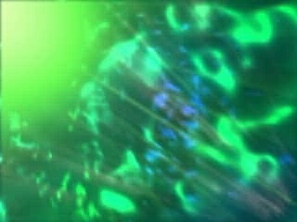
Smoke
Tiny particles of solid and liquid matter suspended in air as a result of combustion
Diesel Particulate Matter
By-products of burning belts
Carbon materials
Usually noxious and toxic gases are present
Can be carcinogen(cancer causing)

Slide 21

Mine damps
The word damp is a derivative of the German word “damf” which means vapor. It was used by the immigrant German miners in the anthracite fields to describe a certain atmosphere condition.
  Black damp: Carbon dioxide, nitrogen, and low oxygen.
  White damp: Carbon monoxide
  Fire damp: Methane
  Stink damp: Hydrogen Sulfide
  After damp: By-products of a fire or explosion

Slide 22
Detection Devices
Hand held detectors
Air Sample
Gas Monitors
Permanent sensor locations
Flame Safety Lamp

